Slide 1
Velocity: The Basics
Scripting with a $ here and a # to do
James “Jamie” Arthur Johnson,
Senior Web Developer,
James Madison University

Slide 2
Prologue of Presumptions
HTML
XML
XPATH
General Scripting
Data Definitions
AND PLEASE: Ask questions throughout the presentation!
Remember:
The only dumb question is the one that needed to be asked but wasn’t.
???

Slide 3

What is Velocity and what does it do?
Java-based Template engine
Standard Java methods
Server-side Language
Traverses XML and transforms into XML/XHTML and other formats
Offers an alternative to XSLT for Formats in Cascade
Source: https://www.youtube.com/watch?v=lLl0DVzRksk

Slide 4

Scripting….
with a $ here
and a # to do
## comment
#* I have a very, very, very, very verbose comment *#
Control structures
Setting variables
looping, macros, etc.
Source: https://www.youtube.com/watch?v=85cL1HisrNc
Variables
Tools

Slide 5

$_XPathTool and #foreach
The XML Data
XSLT
Velocity
νυνι δε
(“nuni de”: “but now”)
<?xml version="1.0" encoding="ISO-8859-1"?>
<villains>
<villain>
<alias>Mr. Freeze</alias>
<name>Dr. Victor Fries</name>
<gender>Male</gender>
<appeared>1959</appeared>
</villain>
<villain>
<alias>Poison Ivy</alias>
<name>Pamela Lillian Isley</name>
<gender>Female</gender>
<appeared>1966</appeared>
</villain>
…
</villains>
<style>#villains th, #villains td { padding: 5px; }</style>
<h2>Villains of Batman</h2>
<table border="1" id="villains">
<tr bgcolor="yellow">
<th>Alias</th>
<th>Name</th>
</tr>
#foreach($villain in $_XPathTool.selectNodes($contentRoot,'/villains/villain'))
<tr>
<td>
$_XPathTool.selectSingleNode($villain, 'alias').value
</td>
<td>
$_XPathTool.selectSingleNode($villain, ‘name').value
</td>
</tr>
#end
</table>
<?xml version="1.0" encoding="UTF-8" standalone="no"?>
<xsl:stylesheet
xmlns:xsl="http://www.w3.org/1999/XSL/Transform" version="1.0">
<xsl:output indent="yes" method="xml" omit-xml-declaration="yes"/>
<xsl:template match="/">
<style>#villains th, #villains td { padding: 5px; }</style>
<h2>Villains of Batman</h2>
<table border="1" id="villains">
<tr bgcolor="yellow">
<th>Alias</th>
<th>Name</th>
</tr>
<xsl:for-each select="villains/villain">
<tr>
<td>
<xsl:value-of select="alias"/>
</td>
<td>
<xsl:value-of select="name"/>
</td>
</tr>
</xsl:for-each>
</table>
</xsl:template>
</xsl:stylesheet>
There are shorter alternatives to $_XPathTool.selectSingleNode($villain, 'alias').value
and
$_XPathTool.selectSingleNode($villain, 'name').value

Slide 6
Variables and Loops
That was then!
XSLT:
<xsl:for-each select="villains/villain">
<xsl:variable name="yr">
<xsl:value-of select="appeared"/>
</xsl:variable>
<p><xsl:value-of select="concat('The villain known as ',alias,' appeared in ',$yr,'.')"/></p>
</xsl:for-each>
Velocity:
#set($villains = $_XPathTool.selectNodes($contentRoot,'/villains/villain'))
#foreach($villain in $villains)
#set( $yr = $villain.getChild('appeared').value )
<p>The villain known as $villain.getChild('alias').value appeared in $yr.</p>
#end
The XML Data
<?xml version="1.0" encoding="ISO-8859-1"?>
<villains>
<villain>
<alias>Mr. Freeze</alias>
<name>Dr. Victor Fries</name>
<gender>Male</gender>
<appeared>1959</appeared>
</villain>
<villain>
<alias>Poison Ivy</alias>
<name>Pamela Lillian Isley</name>
<gender>Female</gender>
<appeared>1966</appeared>
</villain>
…
</villains>
This is now!
*** If I can getChild, what else do you think I can do?

Slide 7
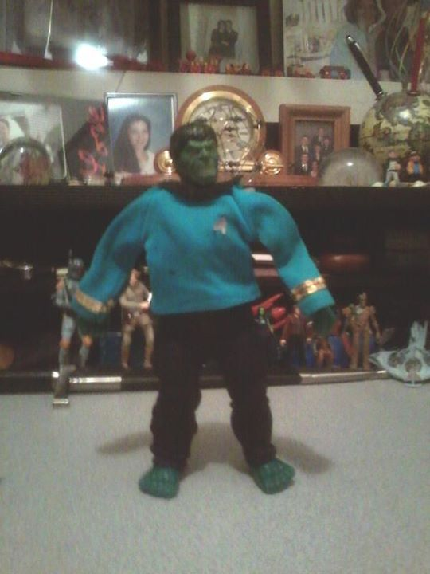


Control Structures
#if(condition)
statements
#end
___________________
#if(condition)
statements
#else
statements
#end
___________________
#if(condition)
statements
#elseif
statements
#else
statements
#end
Image Source: http://www.fanpop.com/clubs/star-trek-the-original-series/images/33456825/title/spock-fanart
Comparison equals: #if($a == $b)
Not equal: #if($a != $b)
And: #if(($a==$b)&&($b==$c))
#if($a==$b and $b==c)
Or: #if(($a==$b)||($b==$c))
#if($a==$b or $b==c)
Greater Than: #if($a>$b)
Less Than: #if($a<$b)
Greater Than or Equal to: #if($a>=$b)
Less Than or Equal to: #if($a<=$b)
Modulus #if($a%2==0)
Photo: Jamie Johnson
Image Source: http://doctorfeelgood.co.nz/wp-content/uploads/2014/06/spock-illogical.jpg

Slide 8
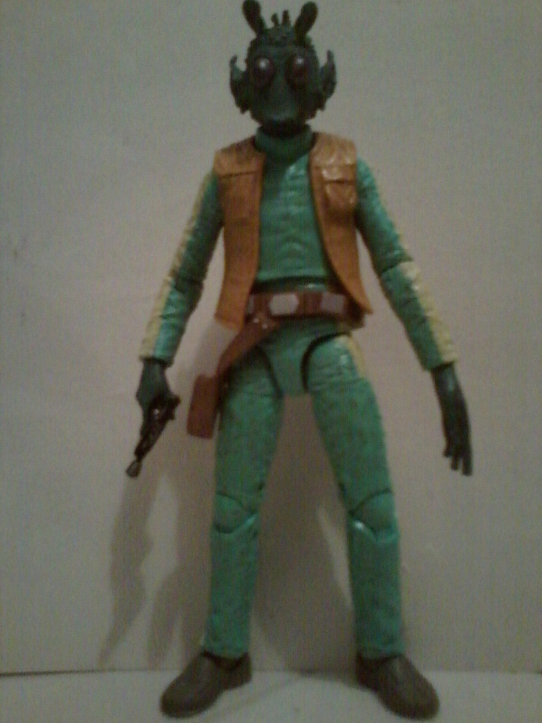
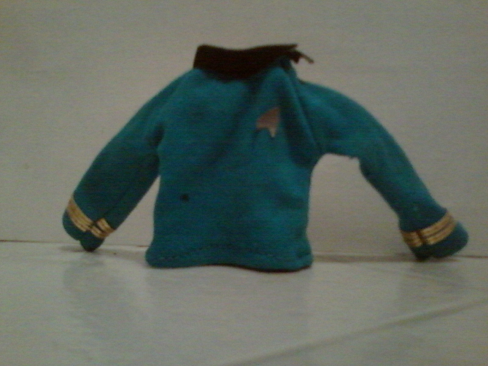
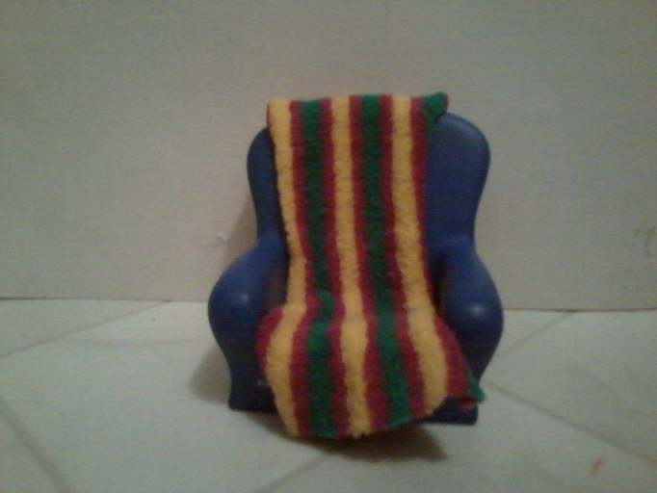
$_SerializerTool
We use the $_XPathTool as you have seen to obtain a value of a node.
However, there are times you will want to serialize.
And we have an XML node in the variable $greedo where $greedo is $_XPathTool.selectSingleNode('greedo')
Say we have a Format:
And we want to obtain this data “housed” in the node:
<greedo>
data
</greedo>
That data’s in him?! Well, maybe Rodians consume Federation shirts! It’s just an illustration! Whatever!
Riddle me this: How do we get the data from the node?
Photos and Graphic (at bottom right corner) by Jamie Johnson

Slide 9
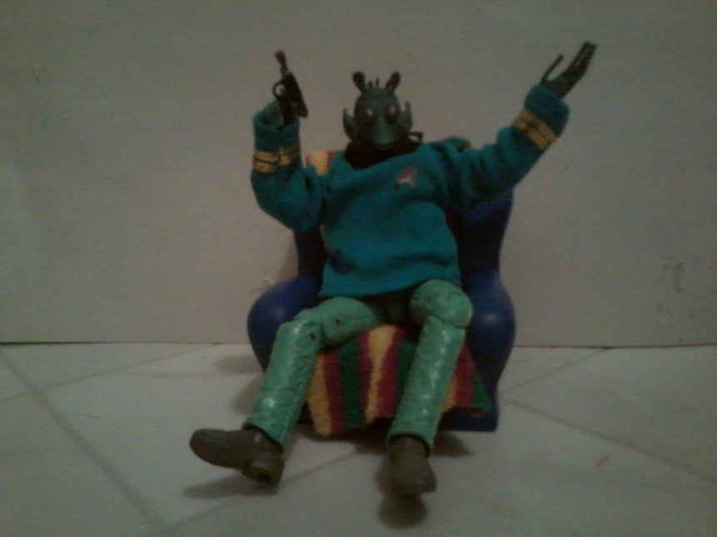
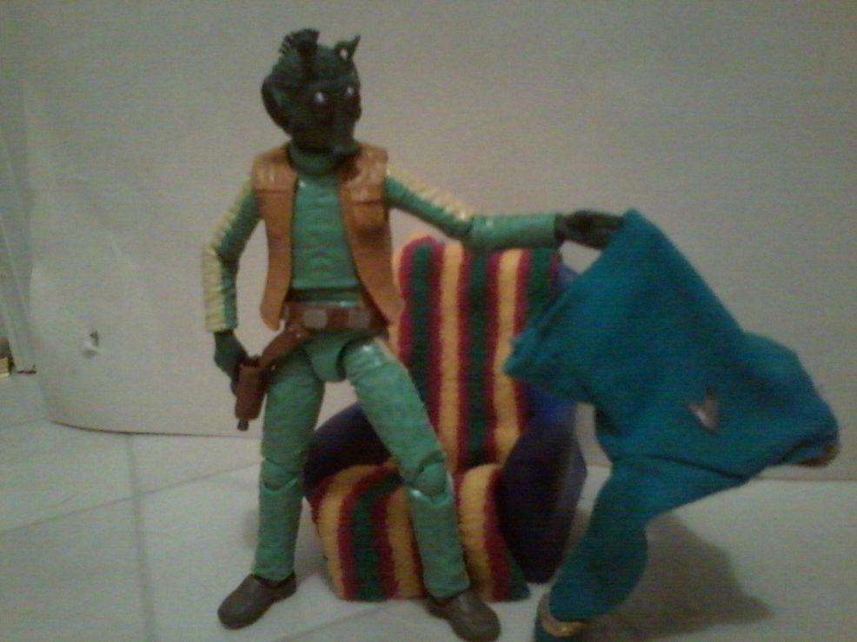
$_SerializerTool – How? (continued)
Do we serialize like this?
$_SerializerTool.serialize($greedo.value, true)
While we are after the data when serializing, you have to forget the data initially:
Photos by Jamie Johnson

Slide 10
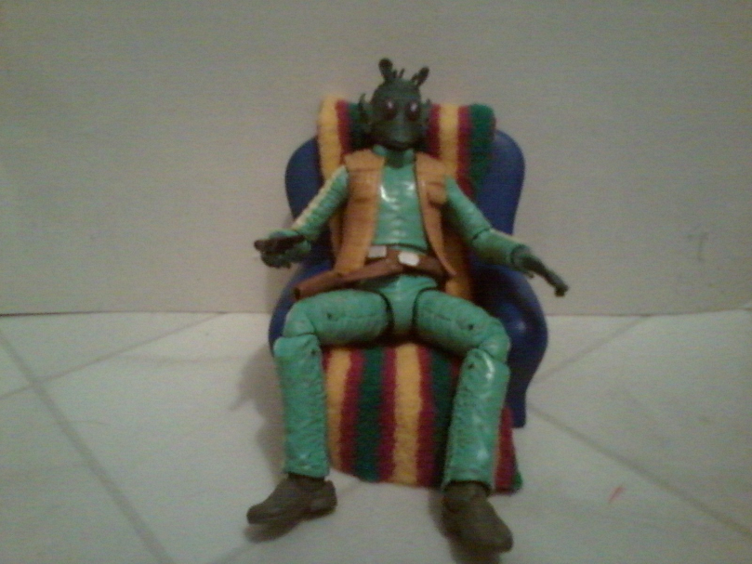

$_SerializerTool – How? (continued)
You have to serialize only the node…
$_SerializerTool.serialize($greedo, true)
… in order to output the data.
Why would we want to do this??
Photos by Jamie Johnson

Slide 11
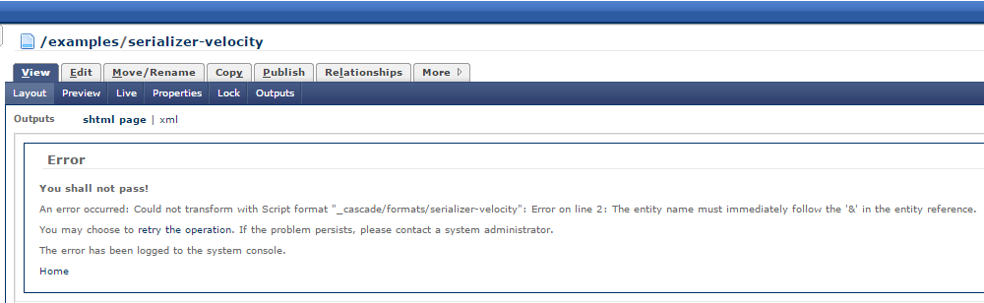
By the way, I broke something…
Can you help me fix it?

Slide 12
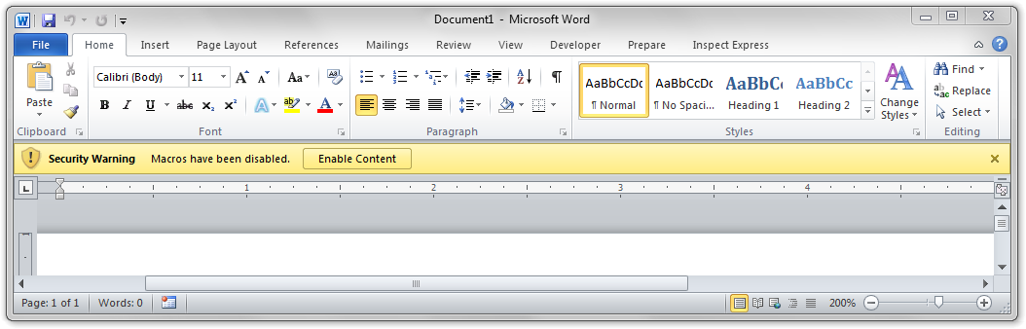
Macros
Think: function or subroutines
Here’s a macro:
#macro(parse_node $node)
<li class="item"> <img src="slideshow_images/$node.getChild('name').text" /> </li>
#end
Here’s how one might call it:
<ul>
#foreach($node in $_XPathTool.selectNodes($contentRoot, '/system-index-block/system-file'))
#parse_node($node)
#end
</ul>
What might the XML structure look like based on the use of the XPathTool?
Um, not this kind

Slide 13
Includes (import)
Macros are good for repeated use within the Format, but if you want to use something across multiple Formats, I recommend using import:
Say you have a Format: /cascade/_formats/myinclude
Say you have a second Format where you want to include the code of myinclude:
#import('/cascade/_formats/myinclude')
What are some practical applications of this?

Slide 14
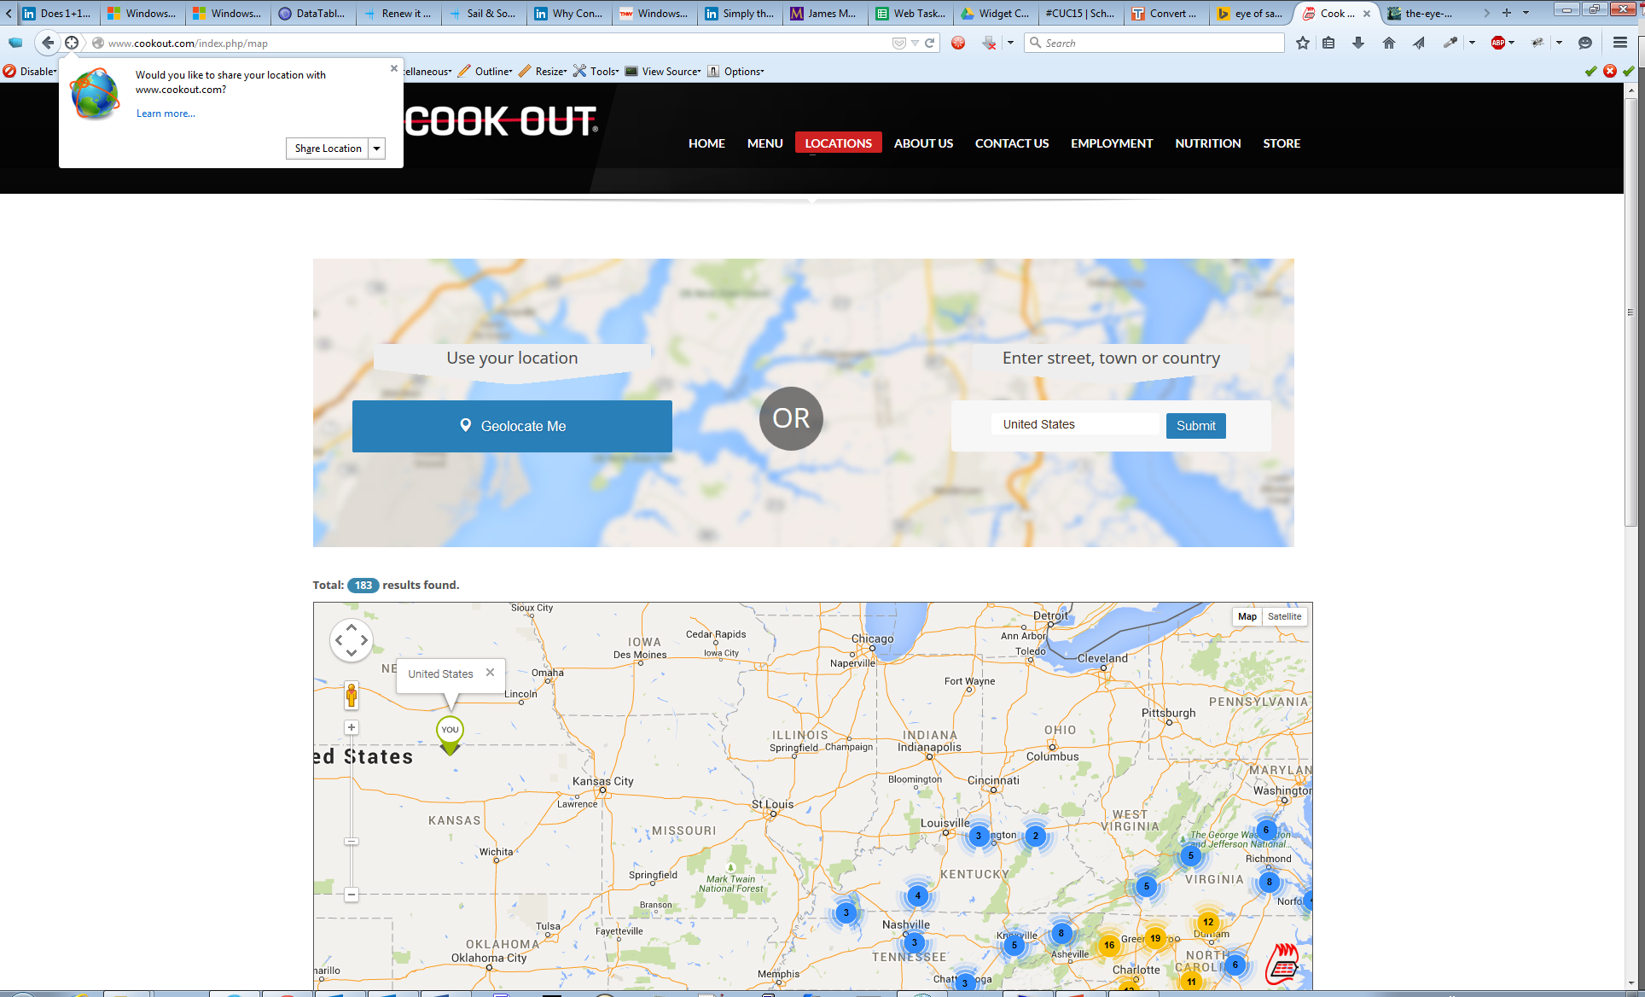
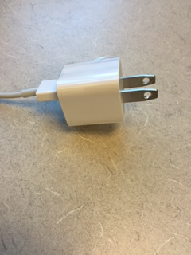
Want to include more? Explore further with the Locator Tool.
To move even further with the idea of including, you will want to consider the Locator Tool (http://www.hannonhill.com/kb/Script-Formats/#locator-tool), where one can include XML, XHTML or other items. With #import, you are limited to including a Format into a Format. With the Locator Tool, you can do much more. And with the Query Tool (Query API of the Locator Tool), there is even more you can do.
These are being presented in “Velocity Accelerated.”
You can also refer to my e-book, which you can order at http://tech.beacondeacon.com/velocity/
Shameless

Slide 15

$_DateTool
How to get today’s date?
#set($startDate = $_DateTool.getDate($node.getChild('start-date').value)) ## assumes a start-date node with epoch date in it
#set($endDate = $_DateTool.getDate($node.getChild('end-date').value)) ## assumes end-date node with epoch date in it
What’s the year? How do I get it?
How about the month?
How about hours or minutes (remember to get date first on these)?
$_DateTool.format() ## This is DateTool’s format method in the Format
(Don’t get confused between format() and Format!)
  short, medium, long (not tall, venti and grande mind you!)
  Now let’s look at these:
    'EEEEE MM/dd/yy'
    'EEE MM/dd/yy'
    'EEEEE MMM dd, y'
    'EEEEE MMMMM dd, yyyy'
    'E, d MMM yy h:mm a'
    'E, dd MMM yyyy k:mm a'
    And no, I didn’t push my face against the keyboard to type those!
What’s the difference? Really, what’s the difference()?
Let’s take a look!
Photo credit: http://memecenter.com

Slide 16
$_DateTool – moving forward
Consider looking at the getCalendar() method to use the calendar object and its methods such as setTime() to set time to a specific date.
Also consider exploring use of the $_FieldTool and its applications with the calendar.
You can learn more about these in my e-book available at http://tech.beacondeacon.com/velocity/
Shameless

Slide 17
$_StringTool and Strings
#set($mystring = "Let's eat, Bilbo.") LET’S TAKE A LOOK!
#set($mystringA = $_StringTool.substringBefore($mystring, ','))
#set($mystringB = $_StringTool.substringAfter($mystring, ','))
#set($mystringA = $mystringA.toLowerCase())
<p>$mystringB $mystringA</p> ## What is the output? Any changes needed?
#set($whatYouMightSayToAnOrc = $mystring.replace(",", " "))
#set($whatYouMightSayToAnOrc = $whatYouMightSayToAnOrc.toUpperCase())
<p>$whatYouMightSayToAnOrc</p> ## What is the output?
Remember: Commas save lives!

Slide 18
$_DisplayTool
#set($myString = "Cascade User Conference 2015")
$_DisplayTool.truncate($myString,10,'...')
$_DisplayTool.truncate($myString,20,'...')
What if I want to not break in the middle of a word?
#set($myHTMLString = "<i>Cascade User Conference 2015</i>")
$_DisplayTool.stripTags($myHTMLString)
#set($myarray = [1..10])
$_DisplayTool.list($myarray, '<br />')
Let’s check these out!
You can check more out in my e-book mentioned on the final slide.
Also, there will be more about arrays in the later presentation “Velocity Accelerated.”

Slide 19
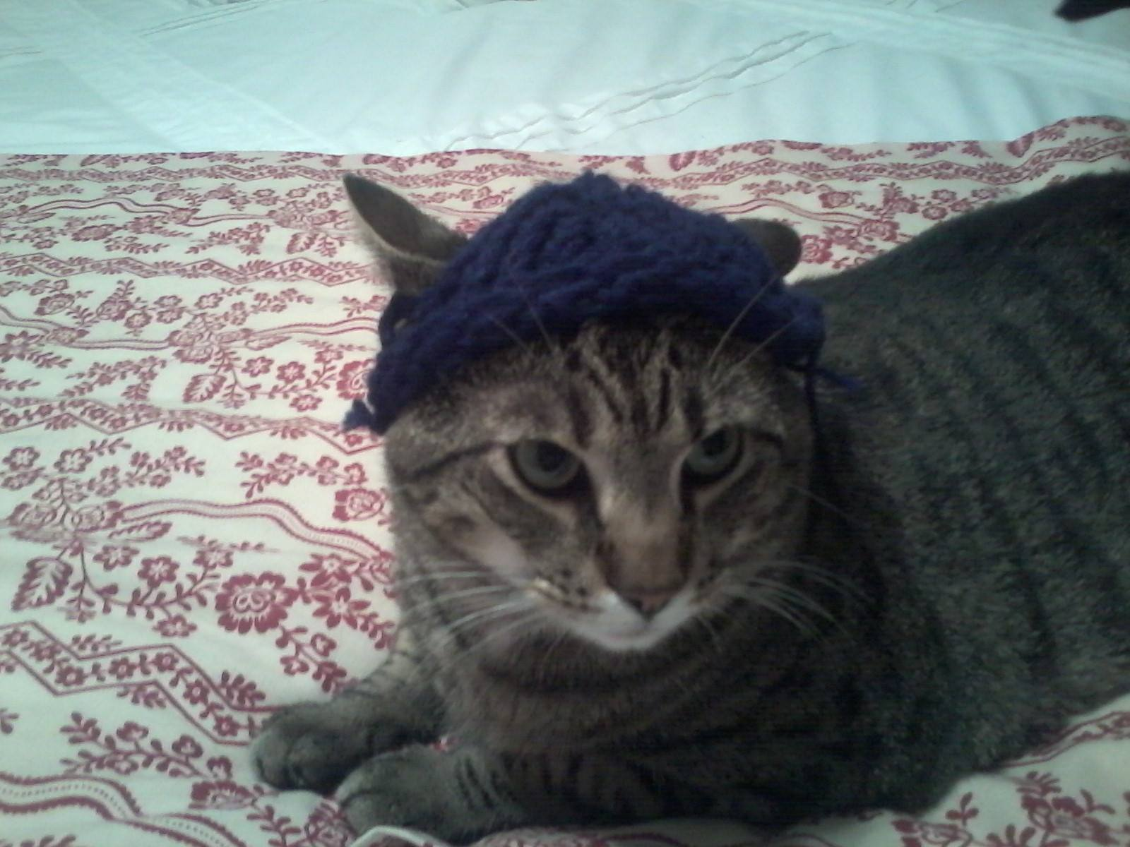

Concatenate and Increment
Concatenate:
#set($title = "Con")
#set($name = "Cat")
#set($name = $title + ' ' + $name)
Increment:
#set($score = $score + 1)
What if I want to increment in a #foreach loop?
Do you think I can use the $_MathTool?

Slide 20
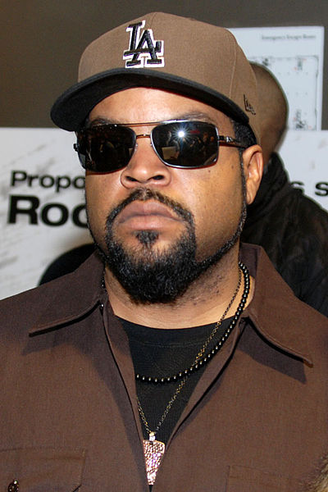
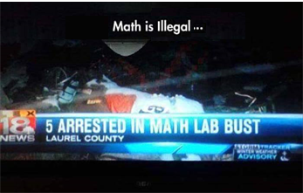

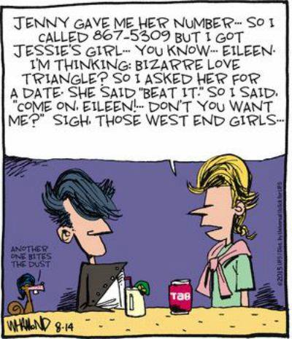
$_MathTool
$_MathTool.toInteger($score)
How do I get Ice Cube(d)?
Or the bigger question:
How do I do any of these?
“Please Excuse My Dear Aunt Sally”
$_MathTool.mod($number,2)
$_MathTool.random(1,100)
$_MathTool.getTotal([8,6,7,5,3,0,9])
$_MathTool.max(8,6,7,5,3,0,9)
$_MathTool.min(8,6,7,5,3,0,9)
$_MathTool.getAverage([8,6,7,5,3,0,9])
$_MathTool.round($_MathTool.getAverage([8,6,7,5,3,0,9]))
$_MathTool.roundTo(2,$_MathTool.getAverage([8,6,7,5,3,0,9]))
Image used with permission; Source: Ice Cube at Chicago screening for the film "Ride Along" at AMC River East 21 Theaters, Chicago, IL, USA on January 9, 2014 by Adam Bielawski
Credit: Tommy Tutone, "Jenny”,
Album Tommy Tutone 2,
Columbia Records, 1981

Slide 21
$_EscapeTool
Here’s a method of the $_EscapeTool used to make your data XML-friendly:
$_EscapeTool.xml($stuff)
Data & XML
“Why can’t we be friends?”

Slide 22
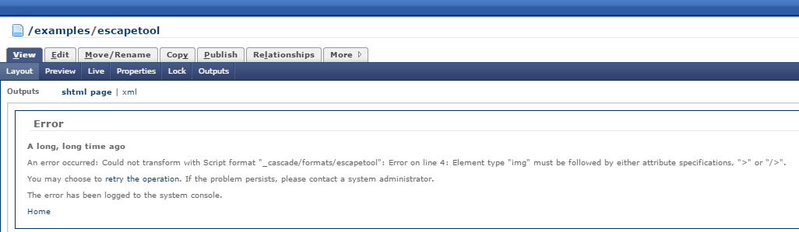
$_EscapeTool
You thought this boy was your only hope? No, there is another. You! Can you help?

Slide 23
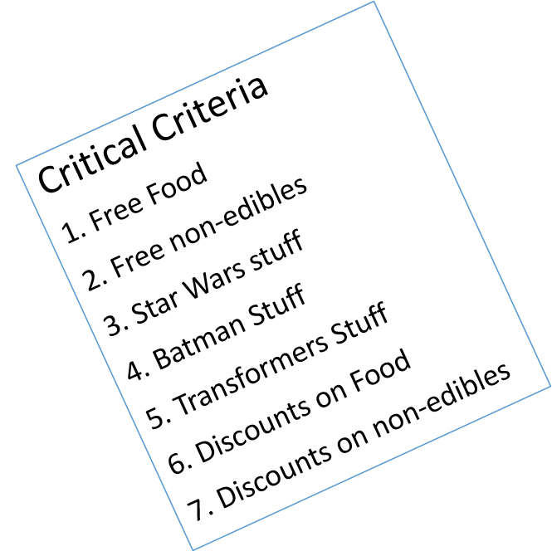
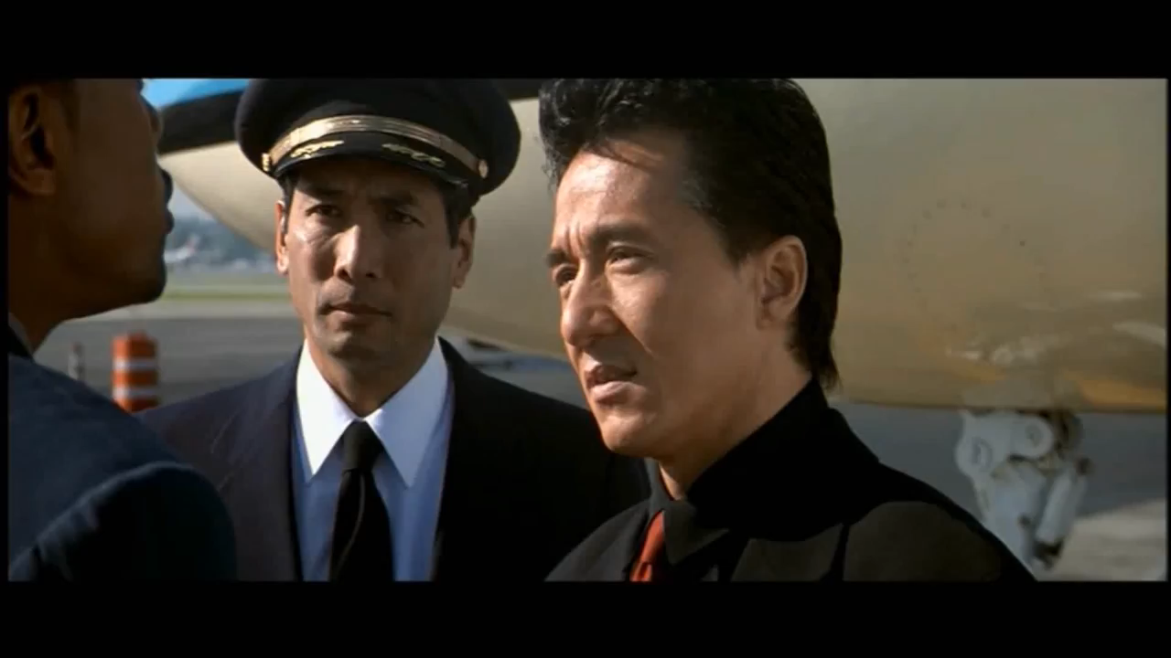
$_SortTool
1) From what group do I want to sort? What tool should I use to get it?
2) addSortCriterion
…or else
A. Node
B. Language
  However, this is optional like “I have read and understand the rules”
  Have you? Really??
  tl;dr :)
Source: https://www.youtube.com/watch?v=cJX1REQB12o
Use with Events
C. Type of Data (does not include Federation or Borg)
D. Order (not Order 66 lest we “wipe them out… all of them”)
E. Case Order
$_SortTool.addSortCriterion("start-date", "en", "text", "ascending", "upper-first") … but you still have to sort!

Slide 24
Helpful Resources
Shameless
Velocity: The Basics: With a $ here and a # to do by James Arthur Johnson: http://tech.beacondeacon.com/velocity/
LearnVelocity: https://www.jmu.edu/cascade/LearnVelocity/index.shtml
Hannon Hill Knowledge Base: http://www.hannonhill.com/kb/Script-Formats/
Velocity source code examples: http://educ.jmu.edu/~johns2ja/cuc15/format-source/

Slide 25
Any Further Questions
???
#set($questions = 'true') ## I hope :)
#macro(hackN2JamiesMind $question)
#if($question == "Where do I get your book?")
<p>Proceed to next slide or go to http://tech.beacondeacon.com/velocity.</p>
#else
        #*
        meanderings and stuff: "I want a snack." "It would be entertaining to hear Mark Hamill use the voice of Joker throughout Episode VII, but only if Chewie is voiced by Kevin Conroy." etc., etc., etc. …
        *#
<p>Jamie will address your question…</p>
#end
#end
#macro(askQuestion $question)
<p>Jamie, $question</p>
#hackN2JamiesMind($question)
#end
#if($questions=='true')
#askQuestion($question)
#askQuestion("Where do I get your book?")
#end

Slide 26
Velocity: The Basics
Scripting with a $ here and a # to do
by
James “Jamie” Arthur Johnson,
Senior Web Developer,
James Madison University
So, where do I get the book?
You can get your copy now (available on Amazon and Google Play):
http://tech.beacondeacon.com/velocity/
And my NEW HOPE is to have the 2nd Edition completed in early 2016!
(That’s 2016 the year, not 2016 factorial, which would be 2.3258495818030913010031406857275e+5788)
Shameless
contact: johns2ja@jmu.edu @JamesArthurJohn

